Slide 1
PYTHON PROJECT
MOVIE GUESSING GAME

Slide 2
PROBLEM ANALYSIS
Learning becomes more efficient when clubbed with fun.
With the same goal to achieve a guessing game always helps in developing the logical aptitude of an individual.
In a movie guessing game, an individual predicts a movie and than goes through an analysis which depicts his performances.

Slide 3
PROBLEM ANALYSIS
Here there are many problems that have to be paid attention like:
Providing different play modes(Single or Multiplayer)
Providing the level of difficulty for step by step growth.
Considering some constraints like avoiding entering vowels, repetition, and indicating the chances left, wrong and right guesses and also displaying the hint at a crucial time.
Movie Analysis through different graphs on different aspects.

Slide 4
PROBLEM DESIGN
This game mainly focuses on developing the predicting ability of an individual. The game will have 2 modes.
In the single mode there will exist a premade list of movie and difficulty levels will be provided to choose from.
In the Multiplayer mode one player will provide the movie and then the movie will hide and the other player will begin with the guessing game.
For every vowel entered or any repetition, an error message will be displayed.
For every right guess, the letter will be added to the incomplete movie.
For every wrong the letter will be added to the wrong guesses list.
The number of chances will be indicated by changing the color of the text “BOLLYWOOD”, wherein for every wrong guess the letter changes from green to red.
After its shown whether the player won or lost, a performance analysis will be shown wherein a pie chart reflects the accuracy of right and wrong guesses, a bar graph and histogram displays the frequencies of vowels and consonants and letters.

Slide 5
PROGRAMMING REQUIREMENTS
There are various functional requirements for the program:
Movie Analysis and game requires the following libraries and packages:-
Matplotlib
Numpy
Pandas
From IPython.display import clear_output
Import time
From random import randint
From colorama import fore
From collections import Counter

Slide 6
PROGRAM STEPS
The first step in constructing the game is making a class Movie that contains functions for entering the movie, entering the hint, displaying only vowels, replacing the space by ‘/’ , replacing the consonants by ‘-‘, so that guessing structure can be formed.
Then the next step is updating and appending the correct choices in the correct blank spaces (here denoted by ‘-‘) in the given movie to be guessed.
The next step is structuring the functionality of the game. For this, it’s required that the guesses made by the player are constantly checked and the constraints are kept in mind that is, no repetition of letters occur, no vowel is allowed to enter by the player and in case the player violates these rules than an error message is displayed. This requires making another class say Bollywood and defining various functions to carry out these operations.
One of the most important parts of making the game is hiding the movie and hint after a given period of time. This is done in the clearOutput() method wherein time and clear_output method is imported in order to carry out the operation.
Then comes making the Single Player mode. Here, File Handling plays a crucial role. A text is created where a list of movies and hints are written and then read into the program in the selectMovie() method of the program. Then the movies are segregated using if else statements into Easy, Medium and Hard.

Slide 7
PROGRAM STEPS
Finally, comes the data visualization part wherein 3 methods are created:
vizShowGuessPie method is created that displays a pie chart of right and wrong guesses of the player, thereby refelecting the performance.
vcFrequencyGraph method counts the number of vowels and consonants in the movie to be guessed and displays a bar graph of the same.
letterFreqGraph method calculates the letter frequencies in the movie. Here the movie is first converted from a string into a list where the spaces are removed to avoid inconsistency in the graph and then copied to a dictionary in order to calculate the respective frequencies. Then finally a histogram is plotted with the help of zip(*most_common() ) method that unpacks the integrated dictionary and separates each letter frequency, and the most common() method here ensures that unique values are plotted and letter with the same frequencies are plotted adjacently. Basically, this ensures a sorted histogram.
Finally through the control structures that is the if else commands, the conditions for choice are defined that is ‘1’ for Single Player Mode, ‘2’ for Multiplayer mode and if any other number is input then an error message is printed. At last all the methods are called.

Slide 8
WORKING
When the game starts running then a welcome message is shown on the output screen.
Then the player is asked to choose between Single Player Mode and Multiplayer Mode.
If the player chooses Single Player Mode than the player is asked to choose the difficulty level that is, Easy, Medium and Hard.
After choosing your preferred level, the guessing game begins. In the game the user is asked to enter a choice till the number of chances are not finished that is till all the letters of the Bollywood displayed on the screen changes to red, the player inputs the choice.
If the input choice is right than the letter gets added to the blank spaces (here denoted by “-“). If the entered guess is wrong the letters in “BOLLYWOOD” changes color (one letter at a time) from green to red and the wrong choice can be seen by the player.
If the player chooses Multiplayer mode then it becomes a game for more than one player wherein one player inputs the movie to be guessed and its hint. Then both of these are hidden after a short while and the game begins for the second player.
Finally, the graphs for accuracy and frequencies are displayed in order to give player an insight of how to predict the choices and displaying the performance of the player.

Slide 9
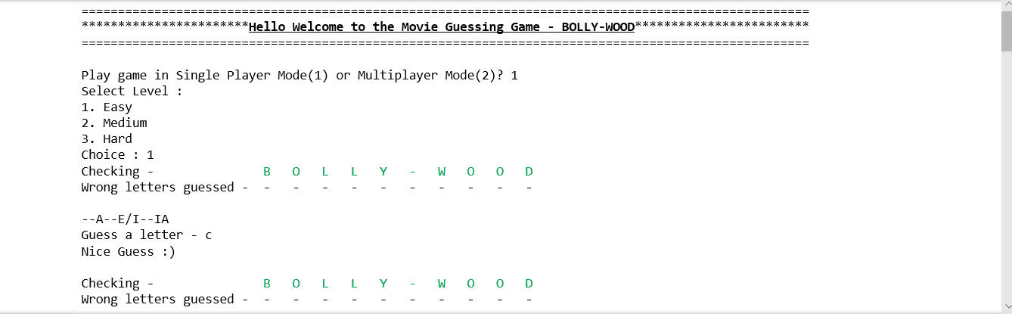
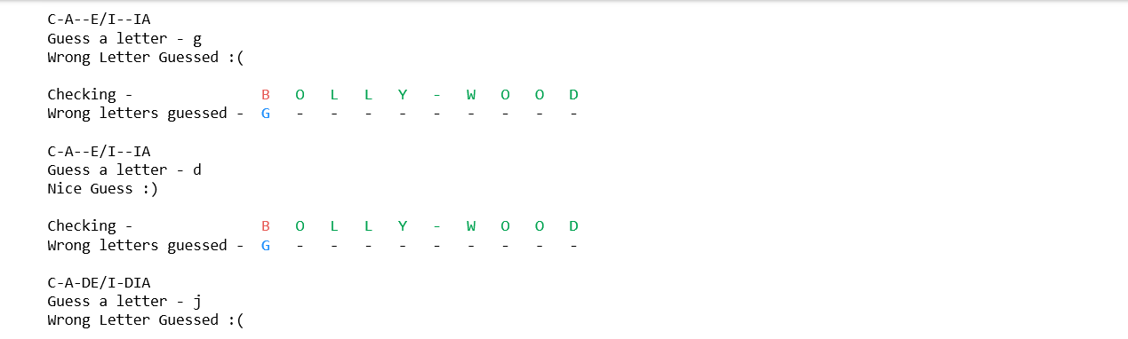
OUTPUT

Slide 10
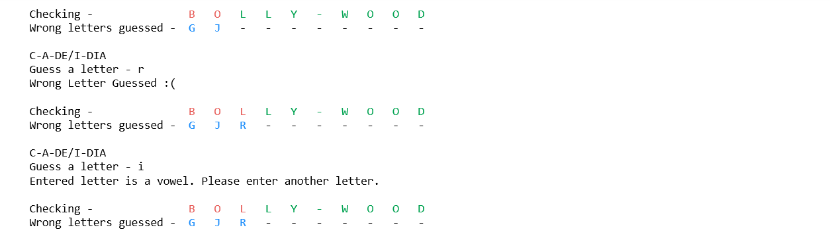
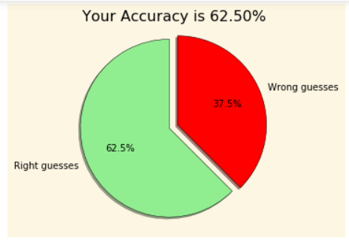
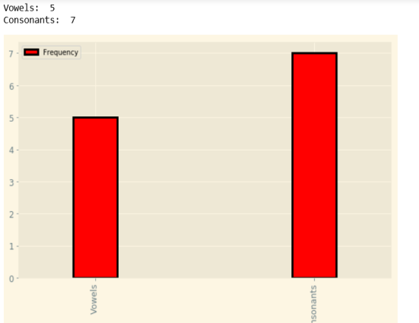
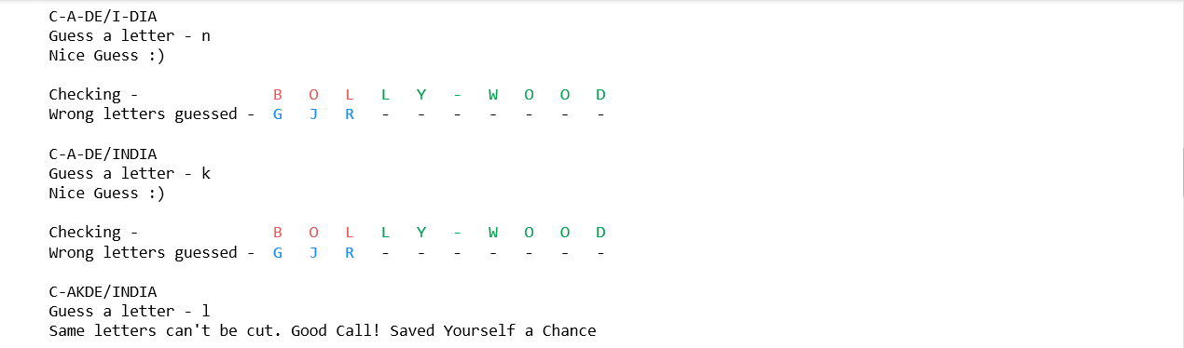
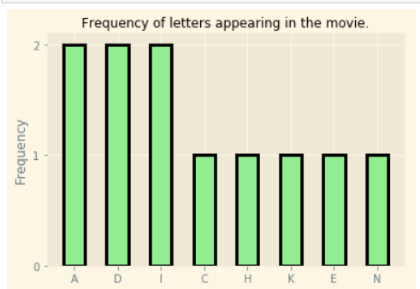
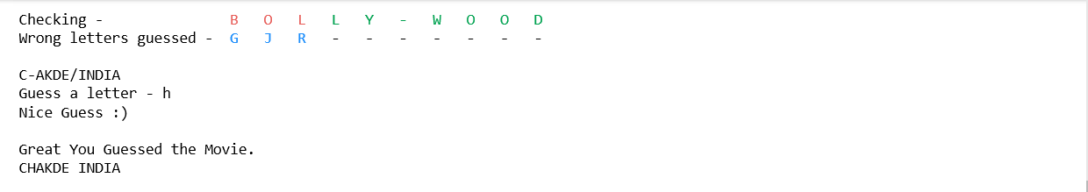
OUTPUT

